Slide 1
Machine Learning in Applications
GROUP FP01
TIME-SERIES ANOMALY DETECTION SO TA PROJECT REPORT PRESENTATION

Slide 2
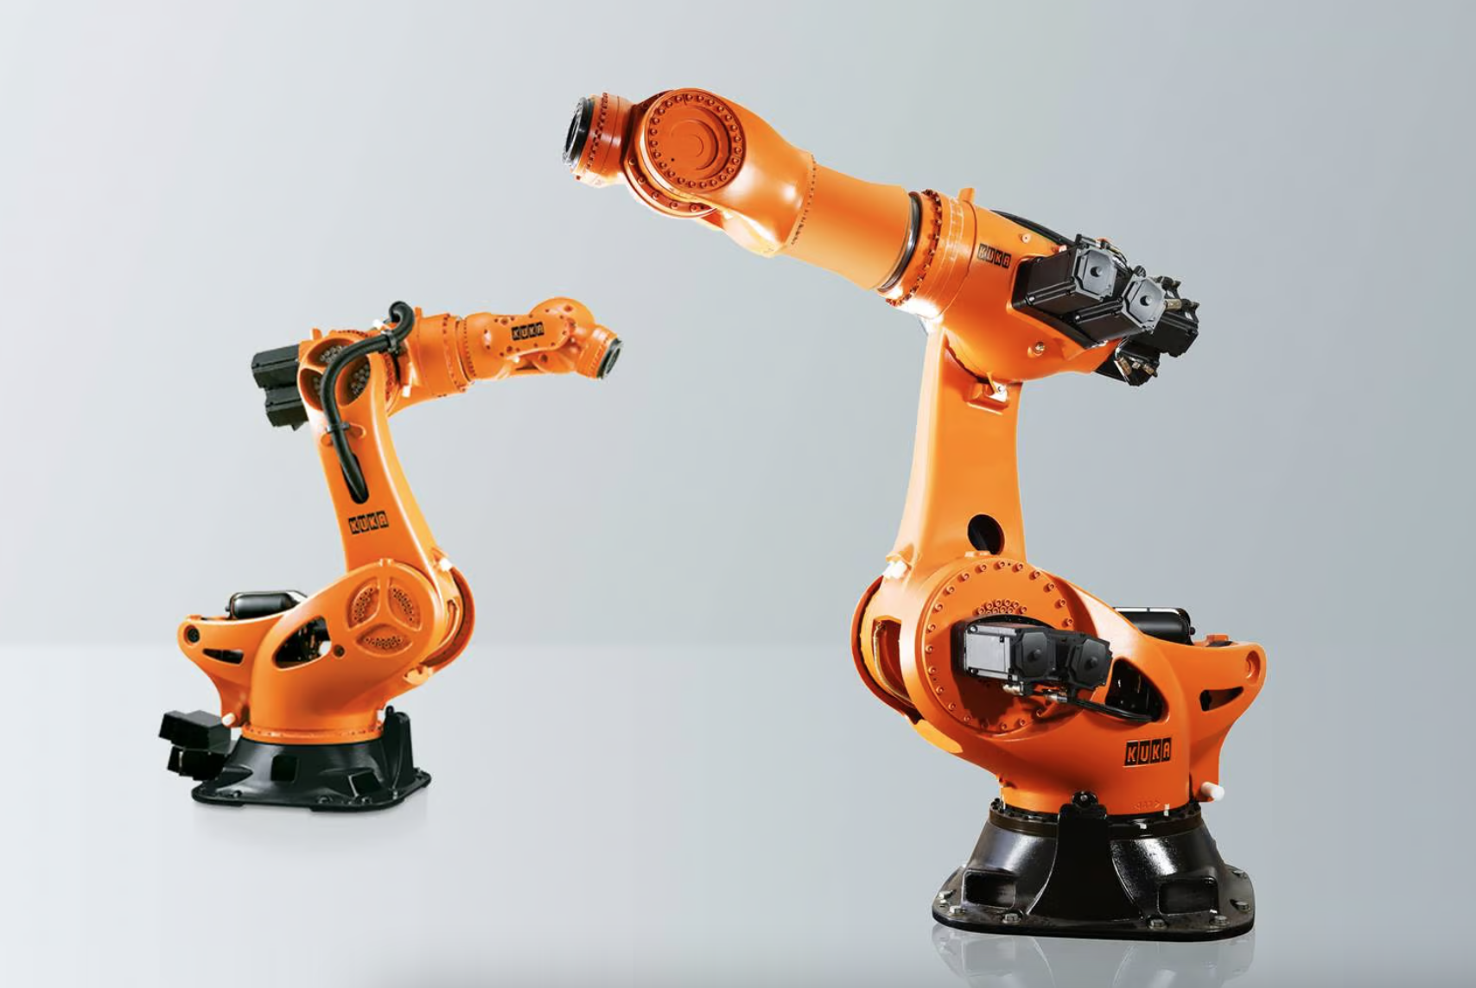
Project introduction
A project to evaluate current Time-series Anomaly Detection models on an industrial robot sensors dataset

Slide 3
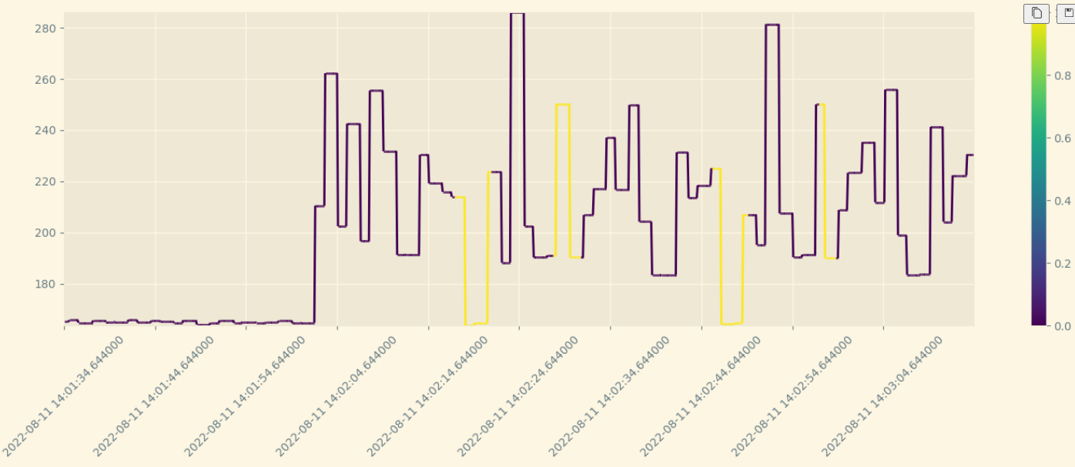
Dataset & Data preprocessing
Time-series data collected from the sensors at 10hz frequency. Each sample consists of 76 features,which encompass information such as different angles movement, current, and power usage values.
For preprocessing, we excluded certain features based on expert input, and we obtained 51 features

Slide 4
Model Selection
TadGAN: Time Series Anomaly Detection Using Generative Adversarial Networks
MSCRED: a Multi-Scale Convolutional Recurrent Encoder-Decoder for time series anomaly detection
MTGFLOW: a method based on Normalizing Flow and GNN
VAE-LSTM: Variational Autoencoder hybrid method using LSTM techniques

Slide 5
Evaluation Metrics
Point-wise evaluation: Since our examined methods
output is in all case a window score, the score for an instance
is obtained as average of the window-scores of windows that
include that instance.
Window-wise evaluation: In order to evaluate a window,
its label is considered positive if there is an overlapping
with an anomaly interval so this bring to an overestimate of
anomalous ground-truth and hence higher AUPRC and maxF1
scores.

Slide 6
TadGan(Timeseries anomaly detection Gan)
TadGan is a model developed by MIT ,it is an unsupervised approach based on Generative Adversarial Network (GAN),
where to capture the pattern of time-series the Generator is trained which is based on LSTM-Recurrent network and discriminators which are based on convolutional network CNN. After training the anomaly detection task is made by using the reconstruction error.

Slide 7
TadGan(Timeseries anomaly detection Gan)-Model Architecture Overview
Encoder: it maps the input data in the latent dimension
Generator: which continuously generate the data both in the original dimension and latent dimension
Discriminator Cx: it has the usage to distinguish the generated time-series and the original time-series in the original dimension
Discriminator Cz: it has the usage to distinguish is to distinguish between random latent samples z ∼ Pz and encoded time series in the latent dimension

Slide 8
TadGan(Time Series anomaly detection Gan)-Wasserstein Loss
The Wasserstein distance used in TadGan provides a smoother gradient flow even when the distributions of the real and generated data are disjoint. This smooth gradient ensures that the generator receives more informative updates during training, leading to more stable and robust training.

Slide 9
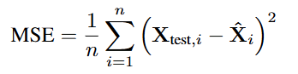
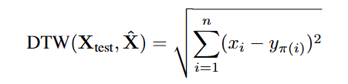
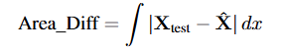
TadGan-Score Calculation Methods
Mean Squared Error(MSE)
Dynamic Time Warping(DTW)
Area based reconstruction error

Slide 10
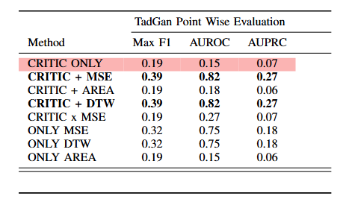
TadGan-Experiment Results
Point Wise Evaluation

Slide 11
TadGan-Experiment Results
Point Wise Evaluation
With the pointwise evaluation, we can see that relying solely on the critic score produced by the discriminator does not provide stability in evaluation. However, by combining the critic score with the reconstruction error calculated using methods such as DTW and MSE, we achieved reasonably high performance in terms of AUROC and AUPRC.
So in the pointwise evaluation the best approaches are CRITIC+MSE and CRITIC+DTW

Slide 12
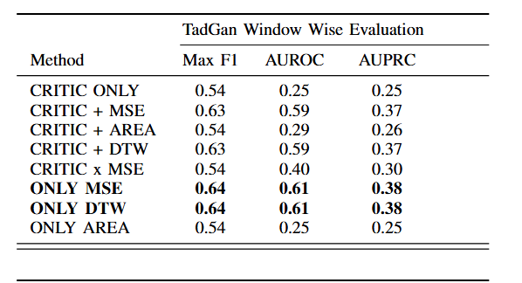
TadGan-Experiment Results
Window Wise Evaluation

Slide 13
TadGan-Experiment Results
Window Wise Evaluation
With window-wise approach, we observe that, on average, the MAX F1 and AUPRC scores are higher compared to the point-wise approach. Furthermore, in the window-wise approach, there is no added benefit in using the critic score. In fact, we achieved better performance by using only the reconstruction error calculated by MSE and DTW methods, without adding the critic score.

Slide 14
MSCRED
MSCRED (Multi-Scale Convolutional Recurrent Encoder-Decoder) is a model
developed for time-series anomaly detection. It was introduced in 2020 by :
Hao Xie, Wenqi Shao, Jianxin Li, Yongdong Zhang, and Qi Song.
Why MSCRED? :
- Highly performing on benchmarks
- Combines CNN and RNN
- Robust to Noise
- Cited and deployed in several application

Slide 15
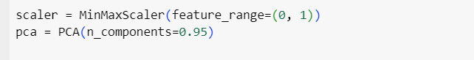
Preprocessing
Model needs the feature space to be scaled in the range [0, 1], this a common optimization for neural networks, favorishing a stable gradient and better convergence.
Also applying PCA can be useful to this specific dataset, 0.95 of the variance is described by 27 features instead of 49.

Slide 16
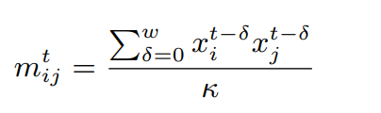
Signature Matrices
Model’s input are not sensor values, but rather a pair wise inner product of the sensor values in a given temporal window, called signature matrix, so each value of the matrix is computed:
The correlation between pair of time series is the key element to identify weather our system status is normal or an anomaly The use of this matrices as input also increases robustness to noise

Slide 17
Architecture
Convolutional Encoder:
Takes as input multiple scales of the signature matrix and captures spatial patterns of these.
Attention based ConvLSTM:
Takes as input the the encoder output and jointly models the spatial patterns of signature matrices with temporal information at each convolutional layer. The attention mechanism is needed to avoid possible ConvLSTM performance deterioration
Convolutional Decoder :
Concatenate feature maps from previous layers with the current and tries to reconstruct signature matrices.

Slide 18
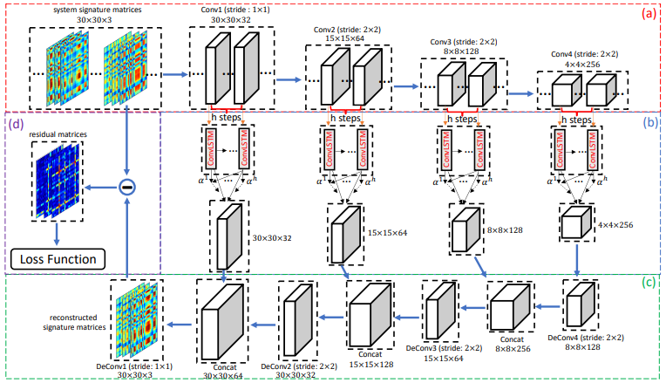

Slide 19
Scoring
Starting from the generated signature matrices, we can compare those with the reconstructed ones that the model outputs, obtaining the squared error of our reconstruction, now several approaches can be used to get a score:
the maximum value of the error matrix
the mean value of the error matrix:
the number of elements of the error matrix above a given threshold
In this application we use the maximum error, beside being the most conservative approach it’s also the better working

Slide 20
Strengths and Weaknesses
Highly effective
Identifies origin of the anomaly
Gives a measure of the severity of the anomaly
robust to noise
deployable in many sectors and across varied datasets
limited interpretability
high computational complexity
high memory usage
sensitivity to hyperparameters

Slide 21
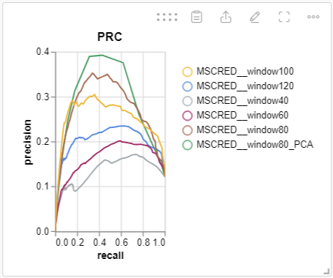
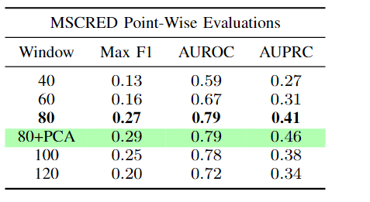
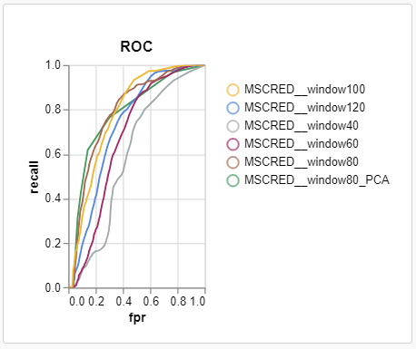
Results
Our implementation is a variant of the original model. It only considers one scale, nevertheless by accurately choosing this parameter we manage to get some impressive results:

Slide 22
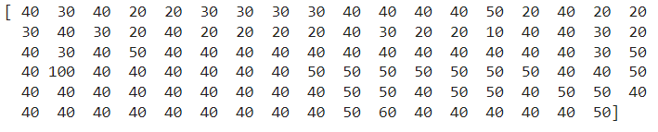
From the result we observe that the best window choice for our application is 80. But what does ground truth tell us?
Ground truth anomalies distribution seems to tend to have mostly windows of 40-50, then using 40 as scale for our model is so underperforming?

Slide 23
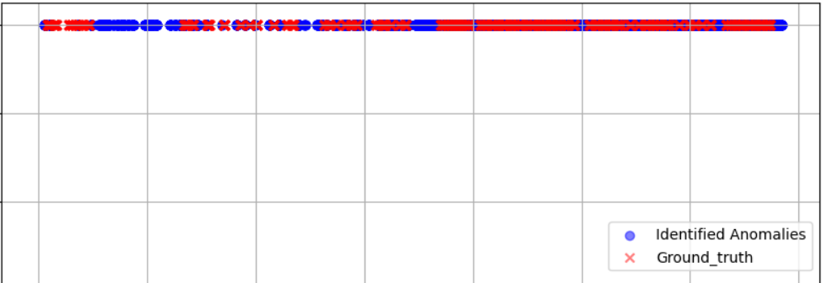
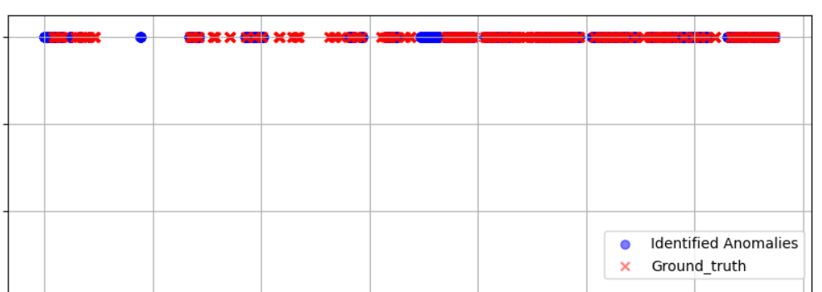
Following we report on top the detected anomalies using 40 as window compared to the ground truth and on bottom using 80. Using window size of 40 leads to many false positive.
Possible causes:
model tend to overfit with lower window sizes
Noise
Not enough memory in the ConvLSTM component

Slide 24
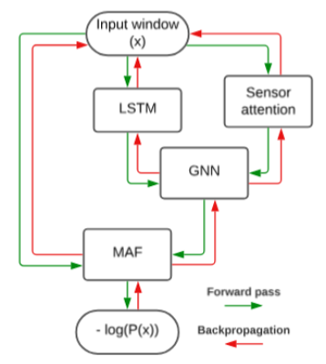
MTGFLOW
Unsupervised method for anomaly detection in multivariate timeseries
Model the probability distribution of a low contaminated (or normal) dataset and, thanks to the modeled distribution, infer whether or not a window of samples is anomalous.

Slide 25
Spatio-temporal features
MTGFLOW is able to take into account both spatial (sensor correlation) and temporal feature thanks respectively to a self-attention mechanism and an LSTM.
This two type of feature extracted from data are then combined with the so called “Graph Convolution” that allows to model a time-dependent correlation graph between entities.

Slide 26
Distribution estimation with MAF
Distribution estimation is performed thorough a MAF applied on entity-wise spatio-temporal feature (global context) and properly transformed input data.
The context informations are passed to MAF like suggested in “Masked Autoregressive Flow for Density Estimation” by simply adding them to the input.
This has been proven to improve MAF performance
No masking is applied in code implementations of MADE blocks for the paper “Detecting Multivariate Time Series Anomalies with Zero Known Label”, we attain to this implementation.

Slide 27
Score system
The loss and the anomaly score both consists of -log(P(x)) estimated by the MAF.
The additional post-processing is applied to make this method (window-wise) applicable to point-wise as described before.

Slide 28
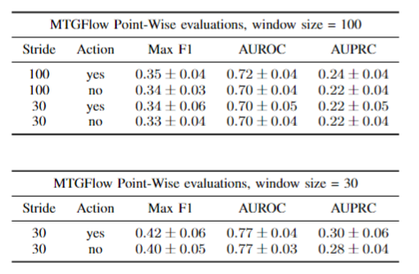
MTGFLOW results:

Slide 29
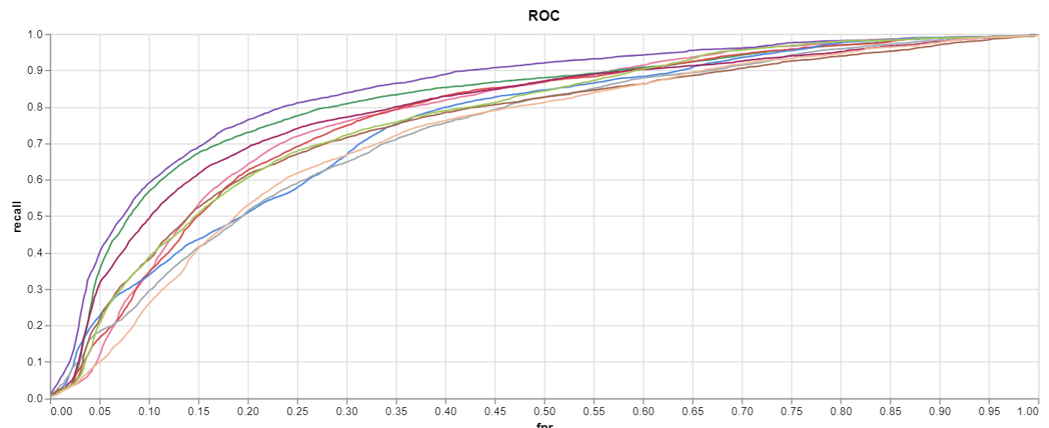
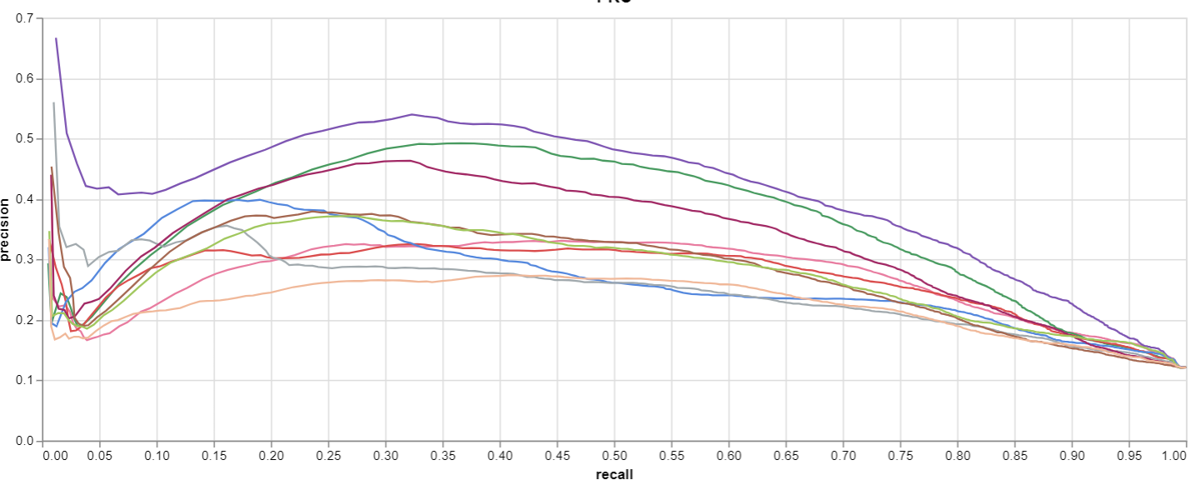
MTGFLOW ROC and PRC
ROC (window size = 30) PRC (window size = 30)

Slide 30
MTGFLOW conclusions:
We tested MTGFLOW even with other hyperparameters (number of blocks and number of entities), obtaining similar results. But only for the reported ones we have tested by training 10 times and averaging over experiments.
The results seem in general good and comparable with other methods considering the evaluated metrics, with a particularly good AUPRC.
→ The model is effective at identifying the positive class without producing too much false positives

Slide 31
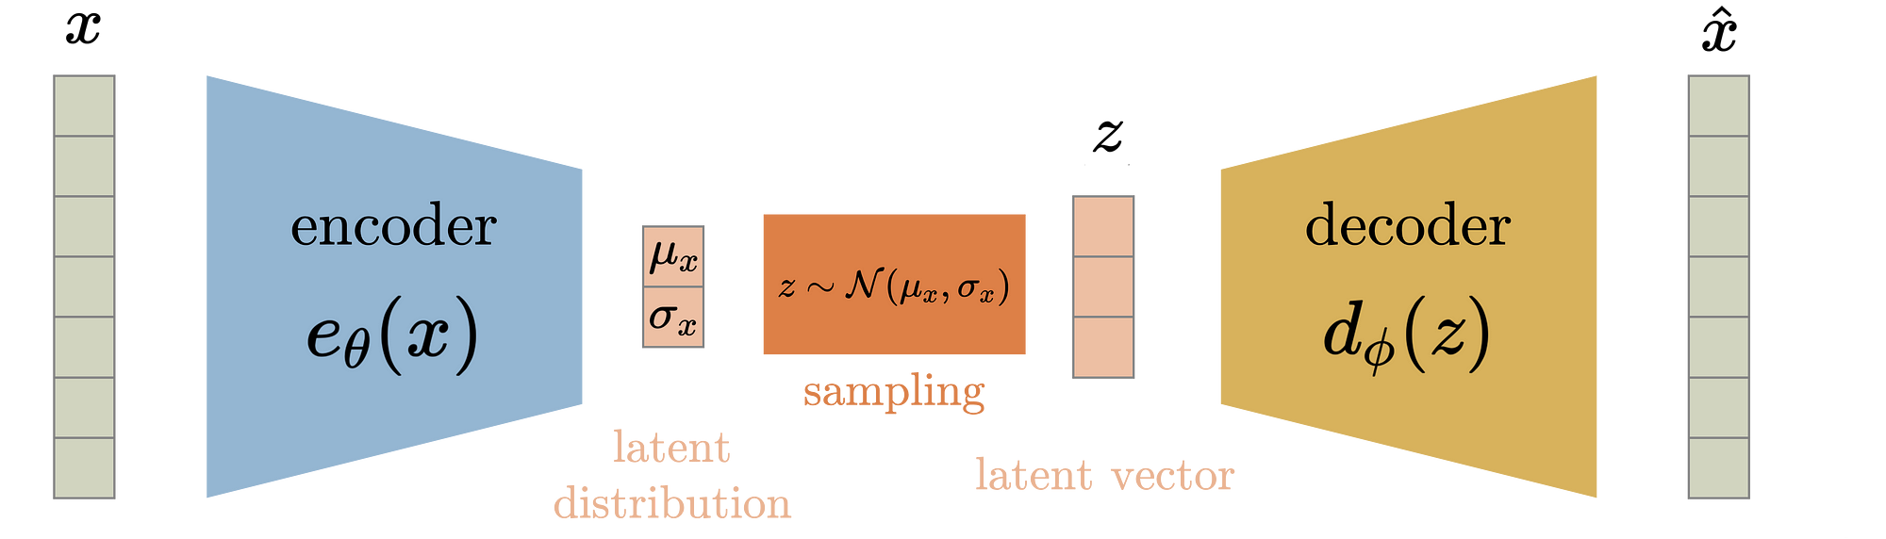
VAE-LSTM
Variational Autoencoder - Long Short Term Memory
The VAE-LSTM architecture integrates LSTM networks into the Variational Autoencoder (VAE) framework to capture temporal dependencies in time-series data

Slide 32
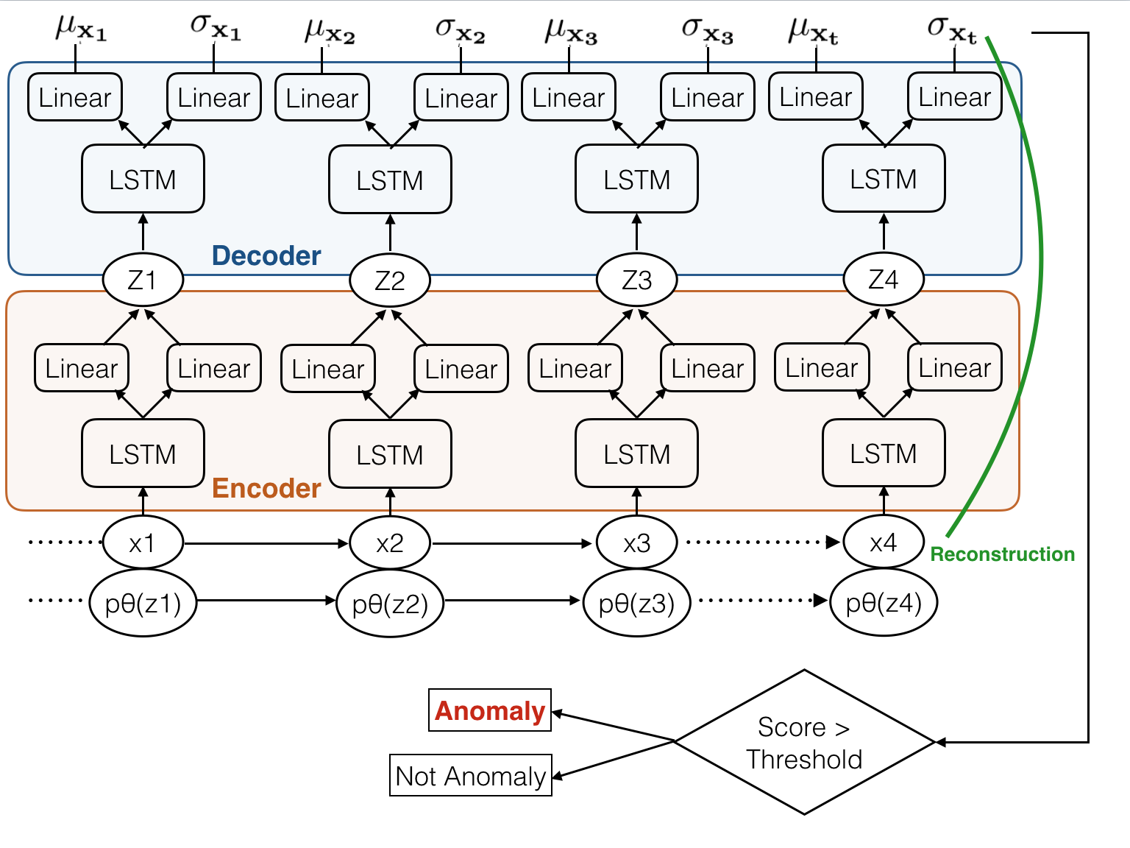
VAE-LSTM
Architecture
At each time step t, the LSTM-based encoder estimates the posterior distribution by passing the LSTM output through two linear layers to compute the mean μ and covariance Σ​​ of the latent variable z​.
The sampled latent variable z is fed into the LSTM-based decoder, which reconstructs the input.

Slide 33
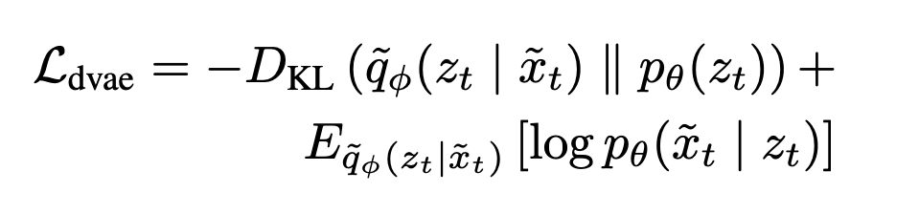
VAE-LSTM
Loss
The LSTM-VAE model is enhanced with a denoising autoencoding criterion by adding Gaussian noise to the input, training the model to reconstruct the original input from the corrupted version.
This approach modifies the variational lower bound to encourage the learning of robust latent representations, improving reconstruction quality and overall model performance.

Slide 34
VAE-LSTM
Issues during training
The model faced significant issues during training, often resulting in NaN (Not-A-Number) loss values unpredictably.
This instability occurred at various training stages, making the process harder and potentially leading to a less efficient model.
Due to these challenges, the results might not be fully representative of the model's potential, and further techniques may be needed to address these numerical issues.
!

Slide 35
VAE-LSTM
Possible reasons
Numerical Instability in KL Divergence: he KL divergence term in VAE can cause instability if the variance becomes too small or large;
Exploding/Vanishing Gradients in LSTM: LSTMs can suffer from exploding/vanishing gradients;
Division by Zero/Log of Zero: Operations like division or log can cause NaNs if zero values appear;
Improper Initialization: Poor weight initialization can lead to unstable activations;
Unstable Latent Space: An unbalanced loss function may cause the latent space to become unstable;
Implementation Error
… and many more

Slide 36
VAE-LSTM
Tested remediation techniques
?
Gradient Clipping
Various levels of input scaling
Various levels of PCA
Lower Learning Rate
Linear layers simplification
Changed Activations
All these techniques helped mitigate the issue but didn’t solve it

Slide 37
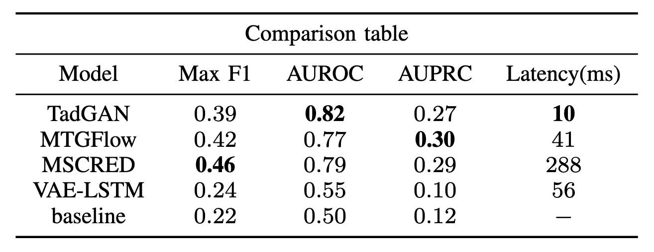
Final Results
MSCRED performs best when threshold refinement is possible
TadGan shows more robust behavior
MTGFLOW has good performance on precision/recall metrics
Window-based approaches consistently working better
Simple latency analysis shows MSCRED as the heavies
Positive effect of PCA (characteristic of the dataset)

Slide 38
Thanks for your attention.

